Slide 1

Introduction to power bi and components

Slide 2
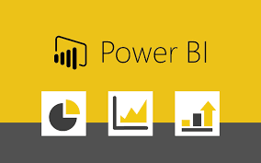
Microsoft Power BI
Power BI is a business analytics tool developed by Microsoft that enables users to visualize data, share insights, and make data-driven decisions. It integrates data from various sources, transforming it into interactive and insightful visual reports and dashboards. Power BI connects to various data sources through a secure and user-friendly interface. Users can quickly explore and interact with their data.

Slide 3
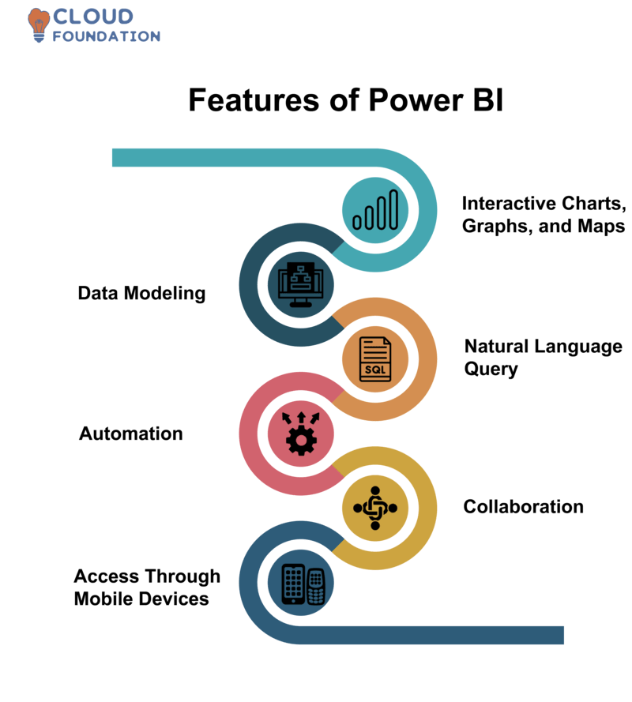
Key Features

Slide 4
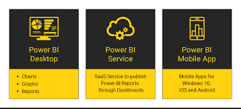
Power BI Components

Slide 5
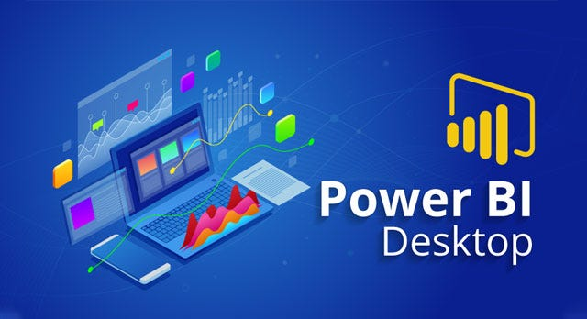
Power BI Desktop
Power BI Desktop is a free, powerful desktop application that allows users to create interactive data visualizations and reports by connecting to various data sources, transforming and modeling the data, and building visuals for insightful analysis. It is a core component of the Power BI suite and is commonly used by business analysts and data professionals to develop robust reports before sharing them via Power BI Service.

Slide 6
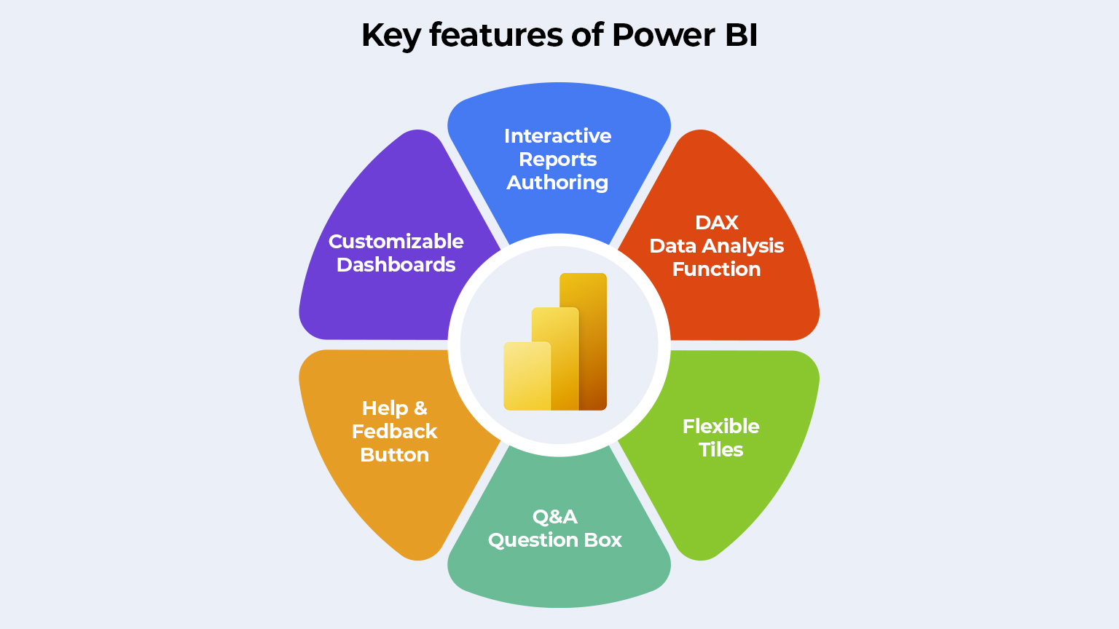
Key Features of Power BI Desktop

Slide 7
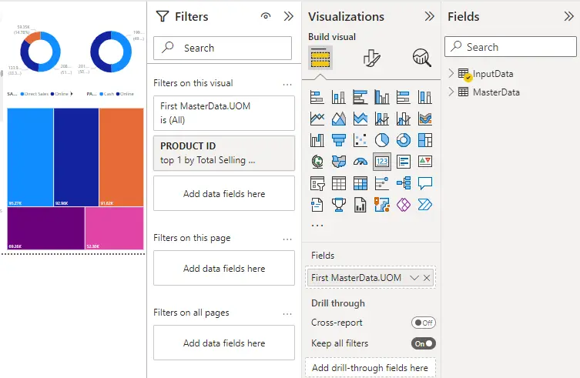
In Power BI Desktop, there are three primary panes that users interact with while creating and working with reports. These panes are crucial for building reports, managing data, and creating visualizations. The three panes are:
Fields Pane
Visualizations Pane
Filters Pane

Slide 8
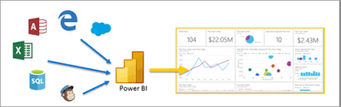
Switching Between Views
Report View: Used to design and create visualizations, reports, and dashboards.
Data View: Used to inspect and validate the raw and transformed data in tabular form.
Model View: Used to define and manage relationships between tables, ensuring accurate data modeling.

Slide 9

Power BI Service
Power BI Service is the online, cloud-based platform for Power BI that allows users to share, collaborate, and interact with Power BI reports and dashboards. While Power BI Desktop is primarily used to create reports, Power BI Service is used to publish, share, and manage them in the cloud, enabling business teams to access up-to-date insights and collaborate from anywhere.

Slide 10

Power BI Mobile
Power BI Mobile is the mobile version of Power BI that allows users to access and interact with their Power BI reports and dashboards on smartphones and tablets.

Slide 11
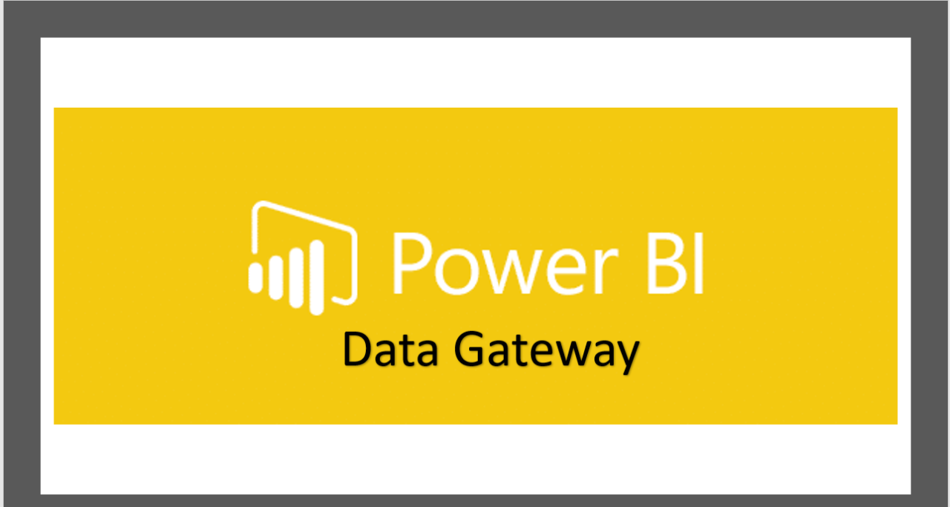
Power BI Gateway
Power BI Gateway is a bridge that facilitates secure data transfer between on-premises data sources (such as SQL Server, SharePoint, or local Excel files) and cloud-based services like Power BI, Power Automate, Power Apps, and Azure Analysis Services. It enables users to refresh data in reports and dashboards hosted in Power BI Service without moving the data to the cloud. This is especially useful for organizations that store sensitive data on local servers but still want to use cloud-based analytics.

Slide 12
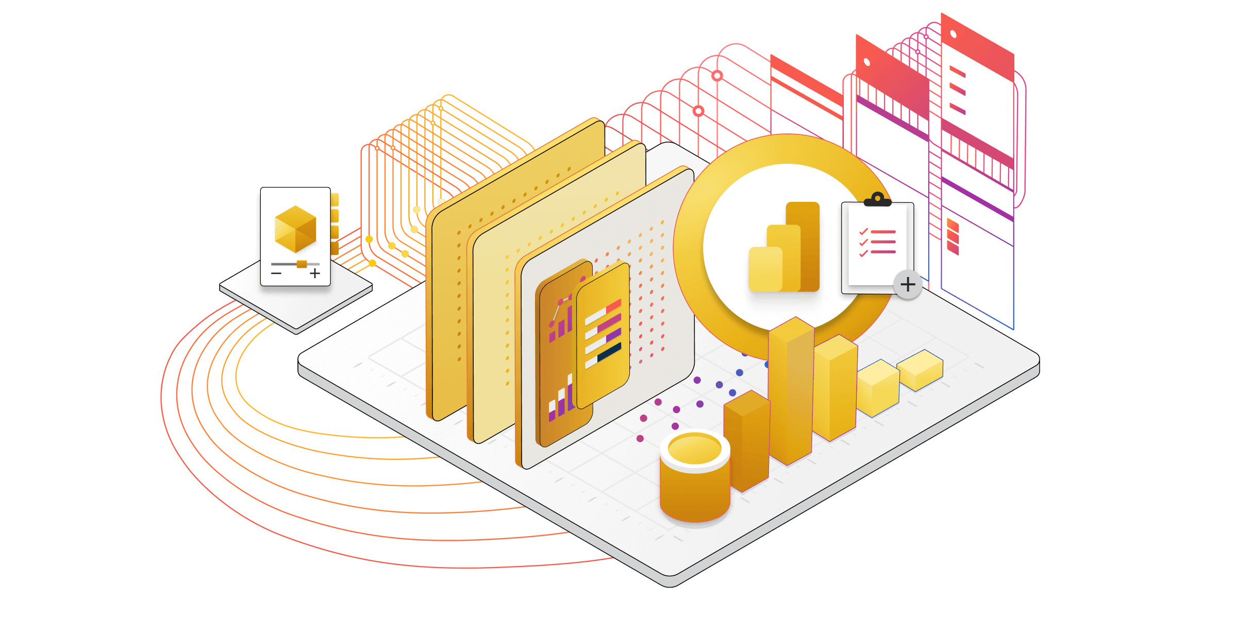
Conclusion
Power BI is a powerful business analytics tool that enables organizations to transform raw data into meaningful insights. With its user-friendly interface, robust data visualization capabilities, and ability to integrate with various data sources, Power BI helps businesses make data-driven decisions. Its strengths include ease of use, flexibility, real-time reporting, and sharing features that promote collaboration across teams. Additionally, Power BI's integration with Microsoft's ecosystem (e.g., Excel, Azure) makes it a valuable tool for businesses already using these platforms.

Slide 13


Thank you
ajaycraju98@gmail.com

